Slide 1
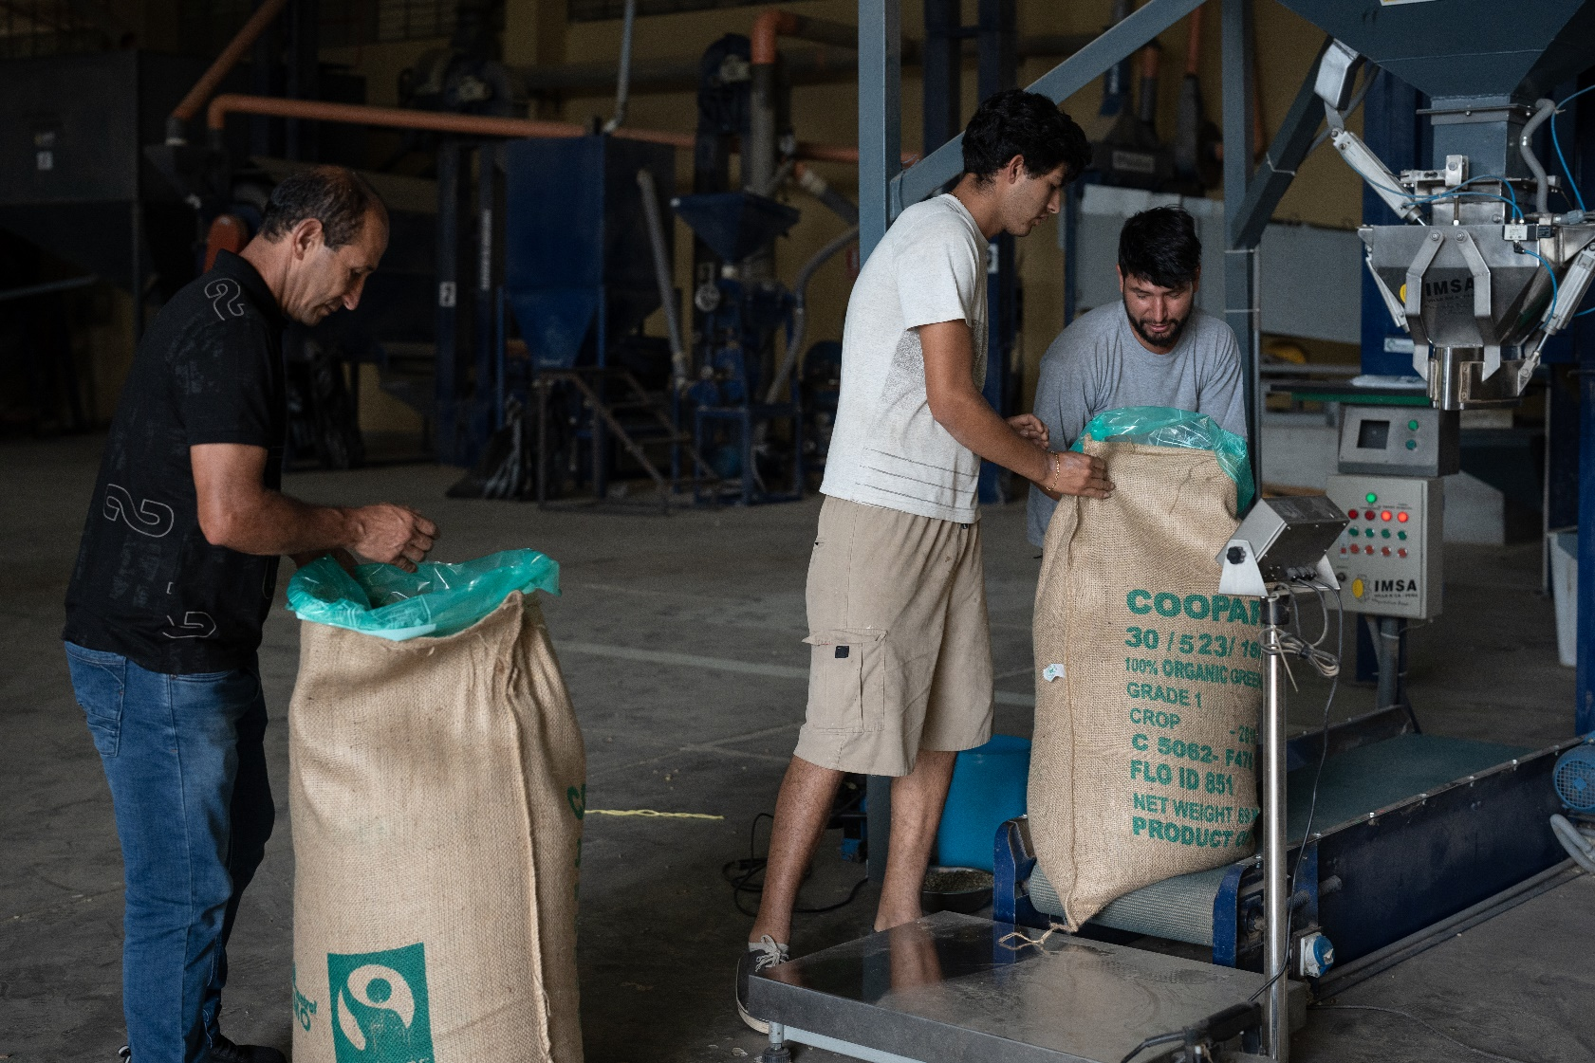
COOPARM
www.shared-interest.com
Notes:
Image shows Alexon Jimenez and Jose Vela Tello do the coffee cupping process at the agricultural cooperative COOPARM in Rodriguez de Mendoza, Peru.
Grown on soaring mountain ranges in rich volcanic soil, or on farms nestled in valleys surrounded by forests, Peruvian coffee is known for its full-bodied aroma and taste. The Amazonas region is one of the main coffee-growing areas in the country and is sometimes referred to as ‘the capital of ecological coffee’ due to the high proportion of organic coffee produced there.
COOPARM (Cooperativa Agraria Rodríguez de Mendoza) is a coffee co-operative located in the province of Rodríguez de Mendoza, in the Amazonas region. The co-operative was founded in 1991 by 100 farmers and obtained organic and Fairtrade certifications in 2008. In 2010, COOPARM became a Shared Interest customer when we provided finance to support the co-operative in exporting their coffee.
Ramiro Bocanegra became General Manager in 2014 and told us that COOPARM faced many challenges. Shared Interest was the sole social lender supporting the co-operative at that time. For this reason, he said: “Shared Interest is at the heart of COOPARM.” Shared Interest finance enabled COOPARM to support farmers in preparing their land for harvest, and provided payment when the coffee was collected. A couple of years later, the co-operative used a Shared Interest loan to acquire machinery and equipment for their dry mill. Ramiro’s immediate focus was on ensuring COOPARM farmers became known for the quality of their coffee and saw it as important that they had the right facilities in place to achieve it.
Due to farms being located at different altitudes, COOPARM harvests coffee continuously and so the co-operative uses its Shared Interest facility all year round.

Slide 2
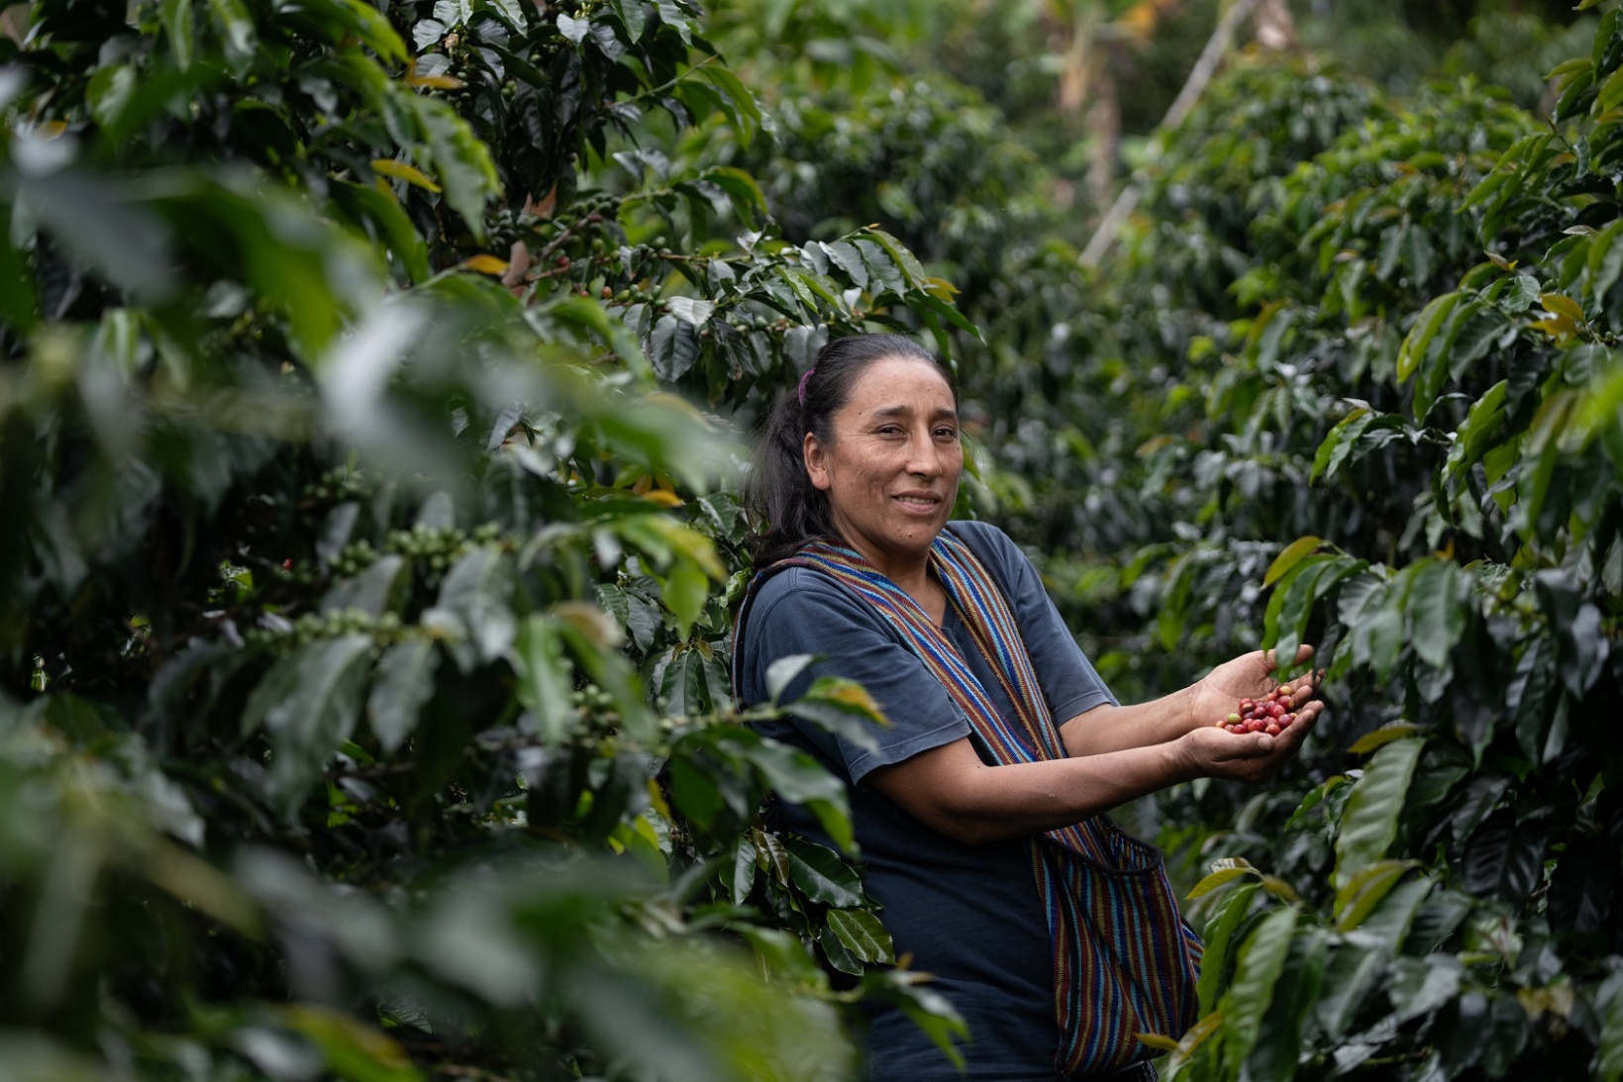
COOPARM
www.shared-interest.com
Notes:
Image shows Elizabeth Arista Salazar harvesting coffee in her plantation located in Rodriguez de Mendoza, Peru.
Elizabeth says:
I first joined COOPARM as a member 10 years ago. At home, I have three daughters and there is me and my husband. Our day-to-day is that I look after the house and my husband and I look after the crop. The focus is to provide an education for our children.
We are up at 5.30am or 6am and make food for later and go out. The coffee plot is about half an hour’s walk from home. At 12pm, I stop for lunch and a rest. At 1pm, I go back to work, picking coffee until 5pm. We take the coffee home by horse in the afternoon; we de-pulp it and put it out to dry. Once it is dry, we take it to COOPARM to process it.
I am President of a female-only committee organised to promote the voice and activities of members. This is my second year as President of the Women’s Committee. Every two years we have an election to replace the roles in March. During the pandemic the committees couldn’t work at all so we are putting a lot of extra effort into getting coordinated to share information and share skills.
At the moment, we have a small project running for a tree nursery to advance the co-operative and secure our future. The reason we are planting the trees, is on the one hand to improve the area where the crop is and also it is very important for us as farmers to work with nature and the environment, to breathe clean air.
Looking after the trees boosts morale. We plant them around the area where we plant our crop, so slowly the idea is to make the place look better.”

